Slide 1

H&m: Personalized Fashion Recommendations Atoosa rashid

Slide 2

Agenda
Problem Area
Proposed Solution
Exploratory data analysis (EDA)
Challenges
Next Steps

Slide 3

Problem area
Core problem: Increased Returns and Decision Fatigue
Minimize Returns: Tailored suggestions ensure customers receive products that meet their preferences and needs
Reduce Decision Fatigue: Customized recommendations simplify the decision-making process for customers, making their shopping experience more enjoyable and efficient.
Boost Sales: By presenting relevant products, personalized recommendations enhance customer satisfaction and increase the likelihood of purchase, thereby driving higher sales

Slide 4
Vision for tackling the problem
Proposed Solution:
Analyzing product performance data
Evaluating customer demographic
Developing predictive models to inform product recommendations and inventory management
Expected Impact:
Impact on Retail:
Enhanced customer experience through tailored products
Increased sales and reduced stockouts
Environmental and Economic Impact:
Better inventory management leading to reduced waste
Lowers cost of returns
Cost savings and increased operational efficiency

Slide 5
Exploratory data analysis (EDA)

Slide 6
Dataset overview
Three datasets:
Articles_df: Data on the articles of products in the transactions in transactions df by the customers in customer df.
Customers_df: Data on the customers involved in making the transactions found in transactions df and articles of products found in articles df.
Transactions_df: Data on the transactions being made to purchase the articles of products found in the articles df by the customers found in the customers df. Note: The prices are not real prices, they are altered.
(Picture data is also available)

Slide 7
Dataset overview
The three data frames are connected via the transactions df:
Transactions_df
customer_df
articles_df

Slide 8

Articles Data frame

Slide 9
Overview of article data frame
Contains mainly categorical information
Has 25 columns, many appear to be redundant
Some of the columns are duplicated as both a string and int, ex. `product_code` and `prod_name` or `department_no` and `department_name`
Depending on the modelling and analysis we continue with we can drop a few of these redundant columns

Slide 10
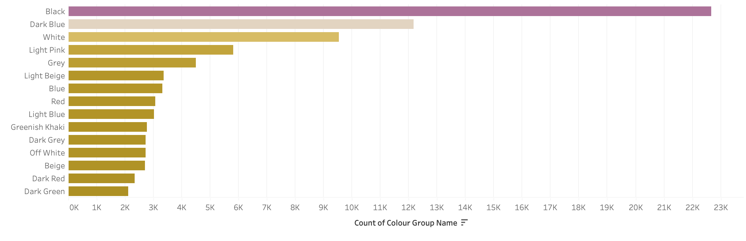
color groups

Slide 11
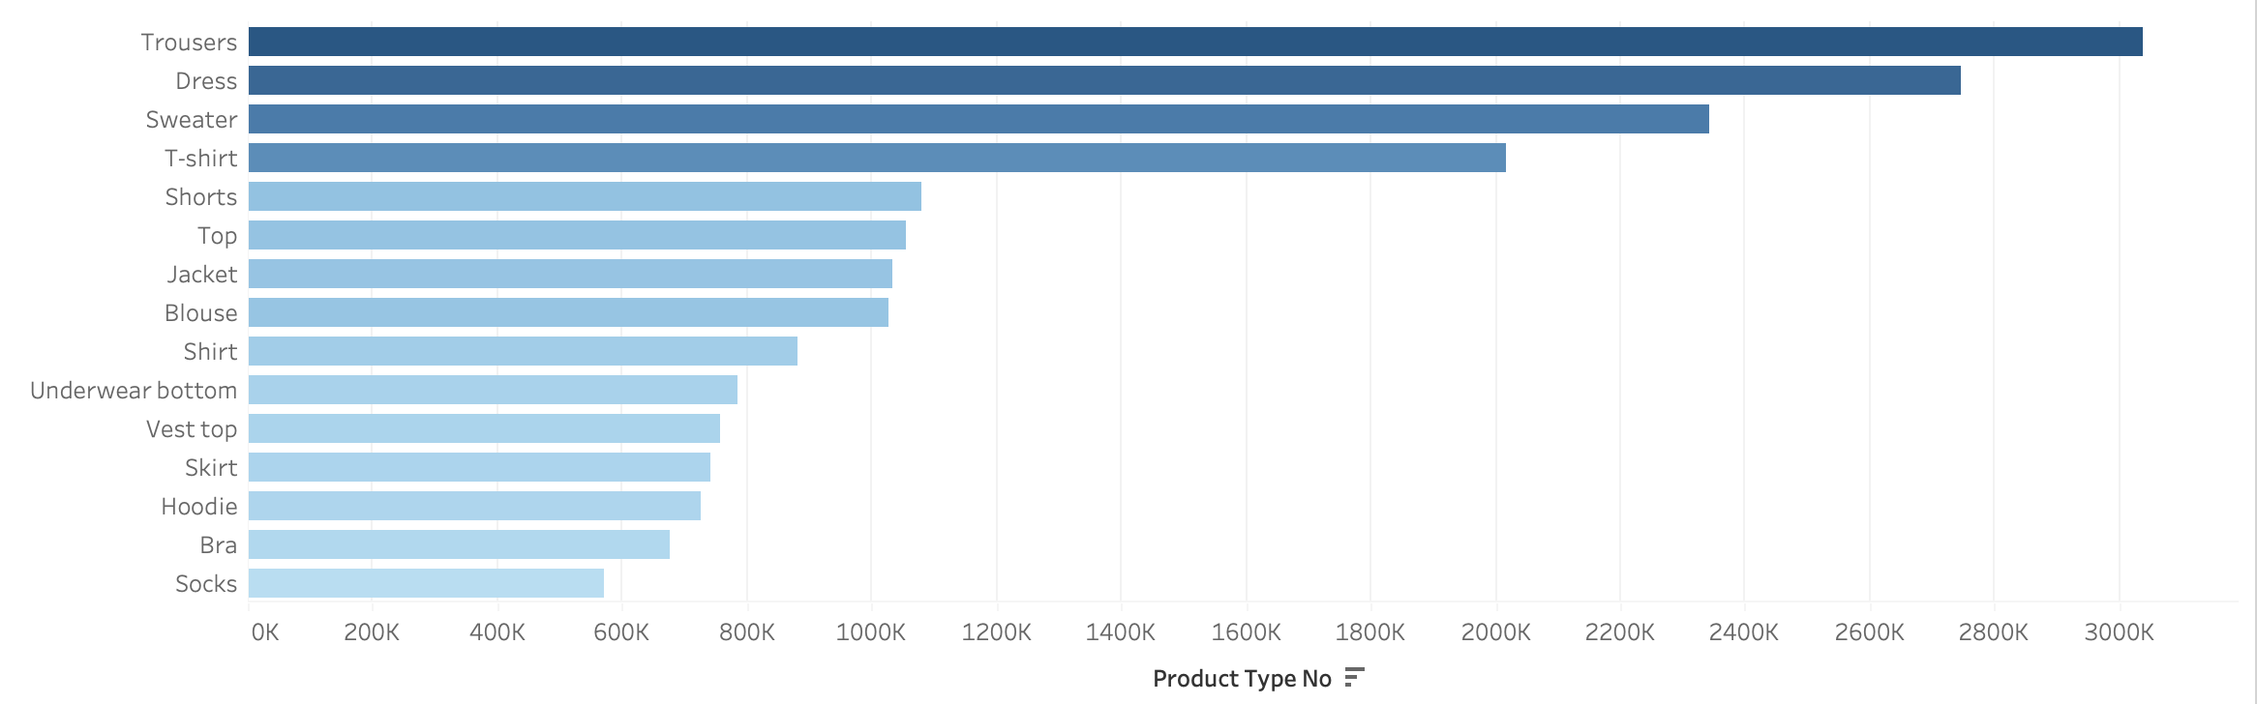
Product types

Slide 12
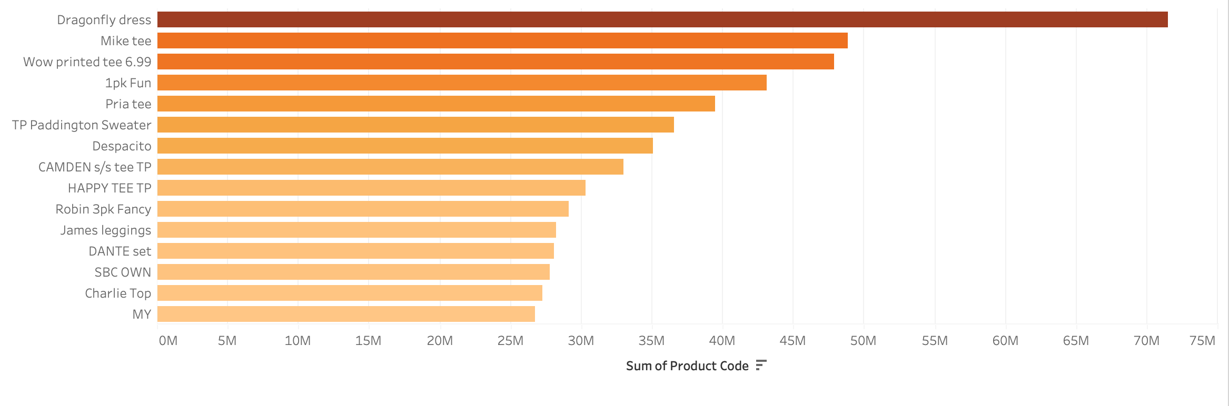
product names

Slide 13
customer Data frame

Slide 14
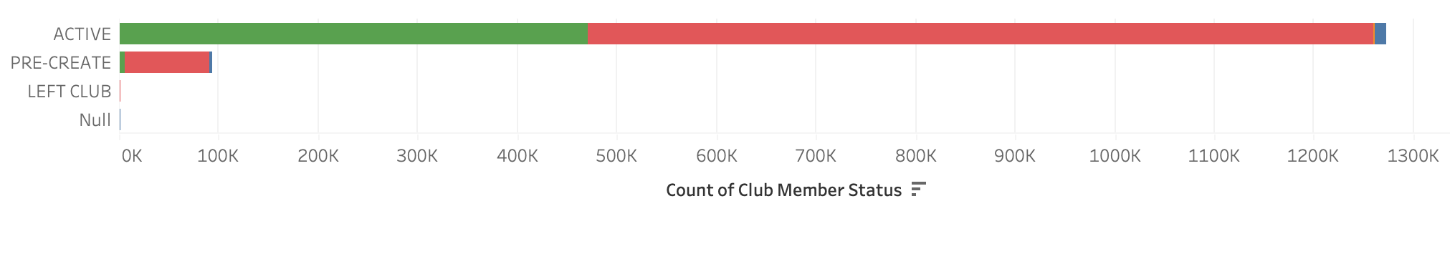
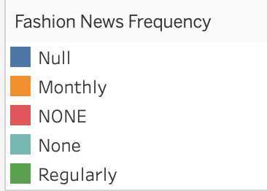
Club membership status and news frequency
Majority of customers are active members of the membership program
Majority of customers do not want to receive fashion news
Important to keep in mind for our recommendation system and methods

Slide 15
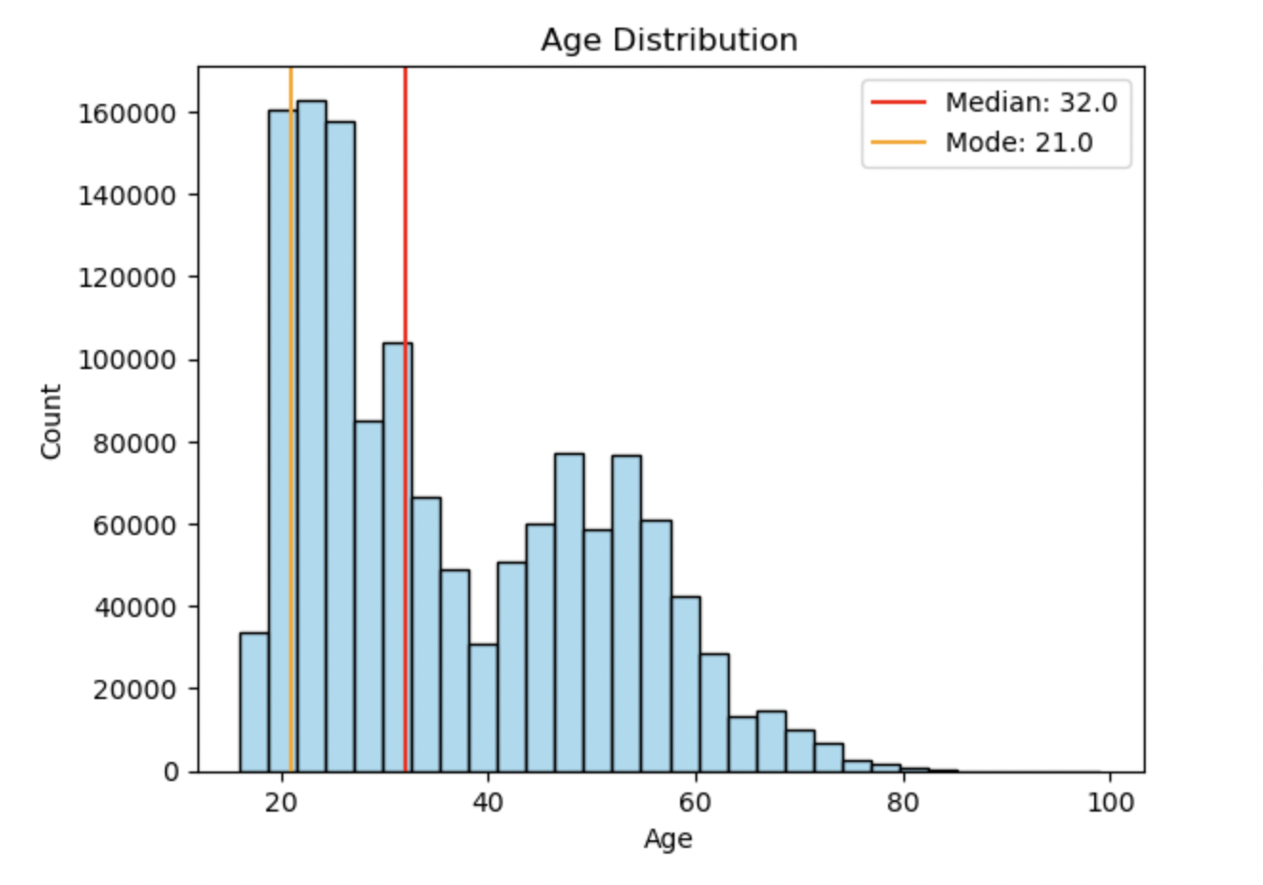
Age distribution
Average age of our customers is 36 years old but the mode is 21 years old
The age distribution is not a normal distribution since it has a right tail
Majority of the customers are below 45, with the peak group being within the range of 20-30 years old

Slide 16
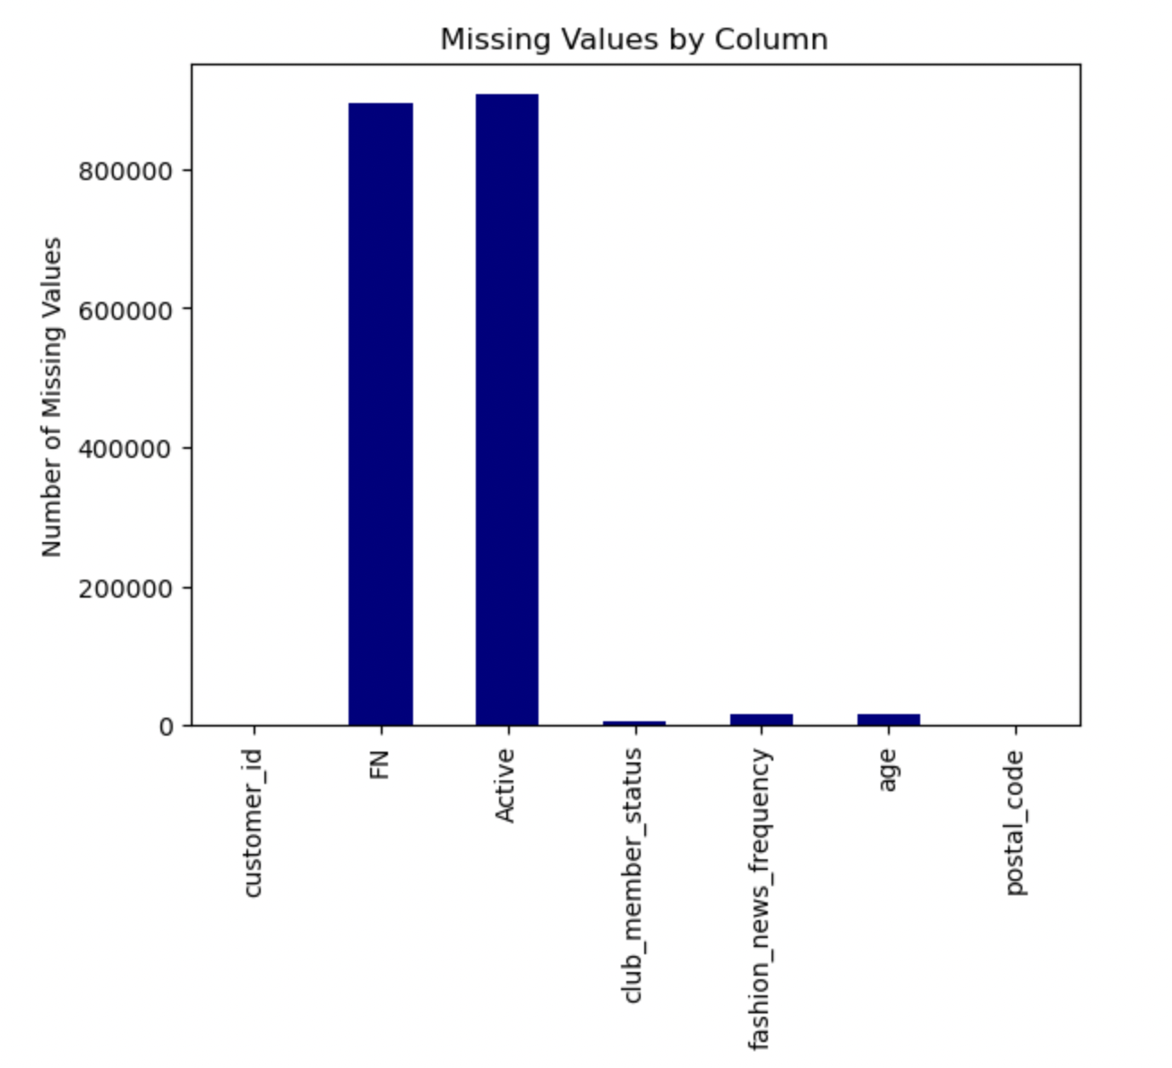
Missing values
Most of the null values are regarding our Active membership and Fashion News

Slide 17
transaction Data frame

Slide 18
Dataset overview
This data set will need to be reduced
The method for reducing the size will depend on our data analysis. A few options include:
Reducing by timeframe: The data set includes data from 2018-09-20 to 2020-09-22, we could reduce it to only one year
Reducing based on price: The data set could be reduced based on the price of the transactions, we could either focus on the lower end or higher end

Slide 19
challenges
Working with the transactions data frame
Working through articles data frame to understand the relevancy of the columns
Understanding recommendation system
Accuracy

Slide 20
Going forward
Removing redundant columns, which will be dropped to streamline subsequent processes
Taking care of null-values present, if necessary
Reducing size of transactions_df
Finding and figuring out appropriate modeling and predictive methods

Slide 21
Thank you
(Constructive feedback is appreciated! )

